Slide 1

离散数学
Discrete Mathematics
钟芳明
离散数学
Discrete Mathematics

Slide 2
Review
Representation method of relation
Digraph
Matrix
Relation operations
Composite of relations
Powers of relation
Matrix representation and diagram of composite relations
Inverse of relation

Slide 3
Closures (闭包) of relations
关系的性质
关系的表示
关系图
关系矩阵
关系的运算
合成
幂
逆
闭包
Definition : given set X, R is a binary relation on X. If another relation R′ satisfies
（1） R′ is reflexive (symmetric, transitive)；
（2） R′⊇R
（3） For any reflexive (symmetric, transitive) relation R″，if
R″⊇R，then R″⊇R′
then R′ is called the reflexive (symmetric, transitive) closure of R.
The reflexive closure（自反闭包） of R is represented by r(R),
the symmetric closure（对称闭包） of R is represented by s(R),
the transitive closure（可传递闭包） of R is represented by t(R).

Slide 4
Closures (闭包) of relations
关系的性质
关系的表示
关系图
关系矩阵
关系的运算
合成
幂
逆
闭包
How to understand the definition？
R
R′
R′′
1
1
1
3
3
3
2
2
2
R ⊆ R′
R ⊆ R′′
R′ ⊆ R′′

Slide 5
Closures operation of relations
关系的性质
关系的表示
关系图
关系矩阵
关系的运算
合成
幂
逆
闭包
Theorem: given set X, R is a relation on X. Then there are:
(a) if and only if r(R)=R, R is reflexive.
(b) if and only if s(R)=R, R is symmetric.
(c) if and only if t(R)=R, R is the transitive.

Slide 6
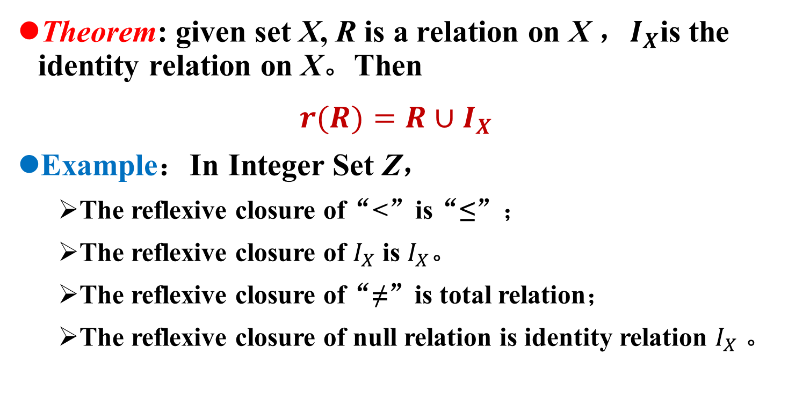
Closures operation of relations
关系的性质
关系的表示
关系图
关系矩阵
关系的运算
合成
幂
逆
闭包
Theorem: given set X, R is a relation on X ，$I_{X}$is the identity relation on X。Then
$r(R)=R∪I_{X}$
Example：In Integer Set Z，
The reflexive closure of“<”is“≤”；
The reflexive closure of $I_{X}$ is $I_{X}$。
The reflexive closure of“≠”is total relation；
The reflexive closure of null relation is identity relation $I_{X}$ 。

Slide 7
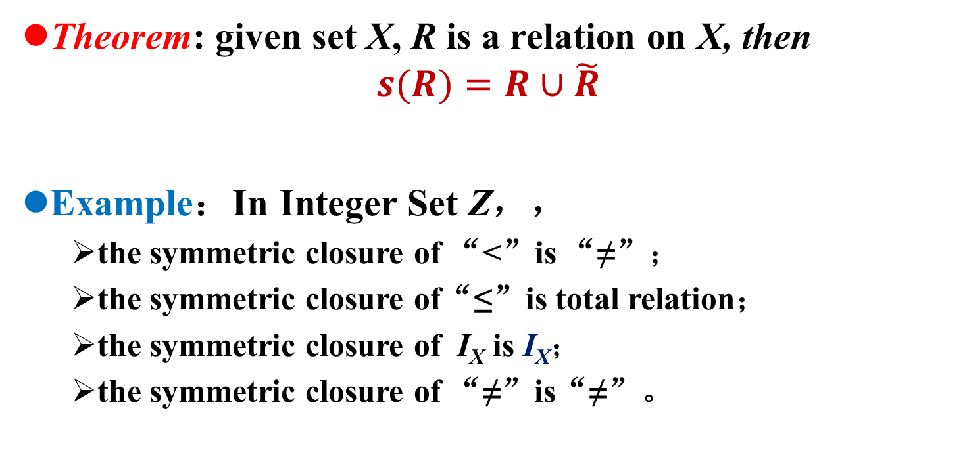
Closures operation of relations
关系的性质
关系的表示
关系图
关系矩阵
关系的运算
合成
幂
逆
闭包
Theorem: given set X, R is a relation on X, then
$$s(R)=R∪\tilde{R}$$
Example：In Integer Set Z，，
the symmetric closure of “<”is “≠”；
the symmetric closure of“≤”is total relation；
the symmetric closure of I_{X} is I_{X}；
the symmetric closure of “≠”is“≠”。

Slide 8
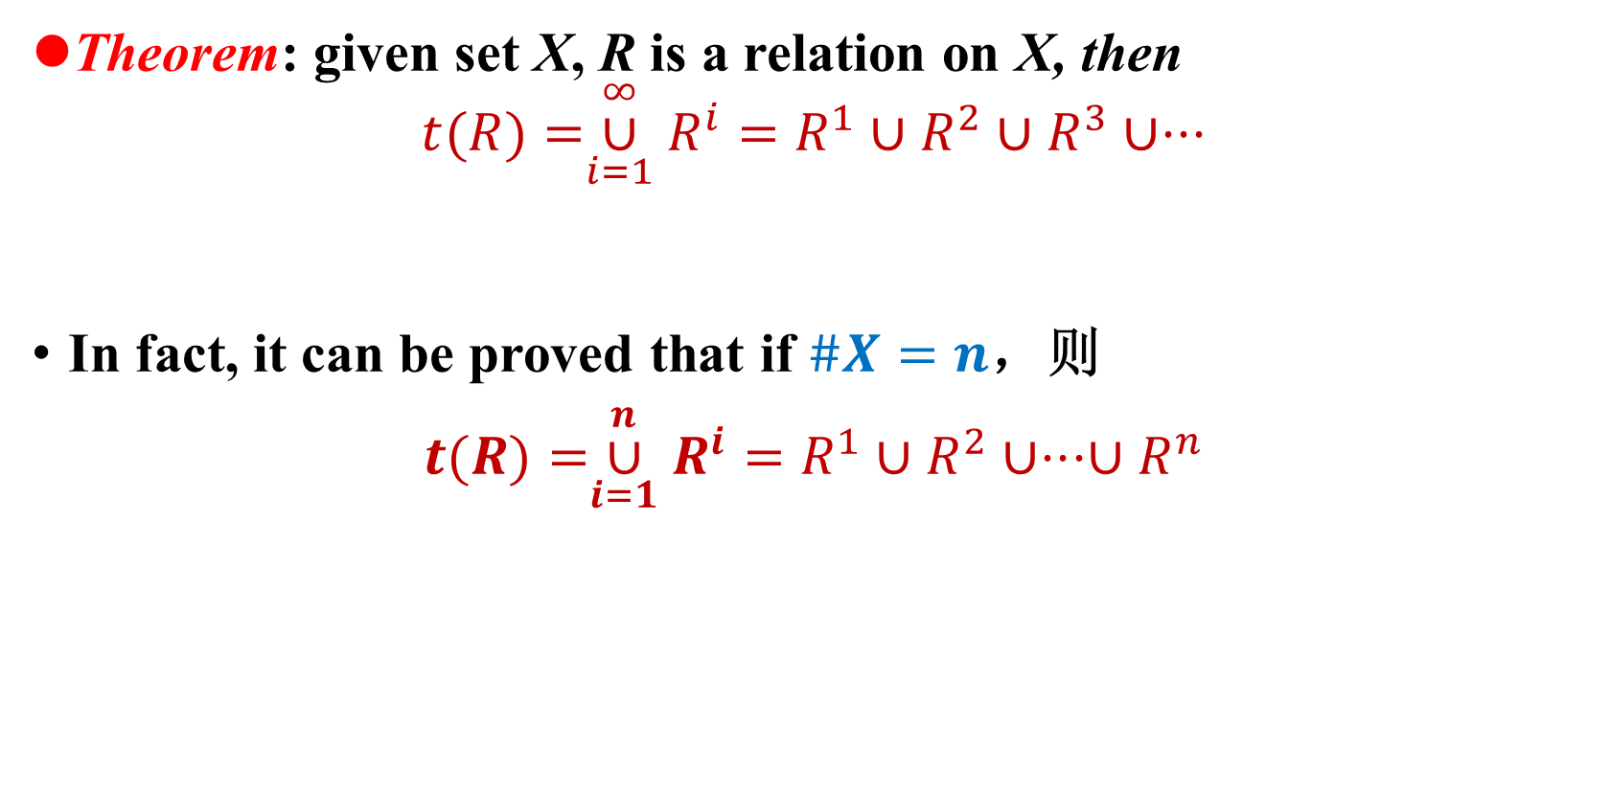
Closures operation of relations
关系的性质
关系的表示
关系图
关系矩阵
关系的运算
合成
幂
逆
闭包
Theorem: given set X, R is a relation on X, then
$$t(R)=\overset{∞}{\underset{i=1}{∪}}R^{i}=R^{1}∪R^{2}∪R^{3}∪⋅⋅⋅$$
In fact, it can be proved that if $\#X=n$，则
$t(R)=\overset{n}{\underset{i=1}{∪}}R^{i}=$ $R^{1}∪R^{2}∪⋅⋅⋅{∪R}^{n}$

Slide 9
Closures operation of relations
关系的性质
关系的表示
关系图
关系矩阵
关系的运算
合成
幂
逆
闭包
Example：Let set X={a,b,c}, R and S are the relations on X，if
Try to find out t(R),t(S), and draw the digraphs of the relations.
Solution：
R,t(R)
S
t(S)

Slide 10
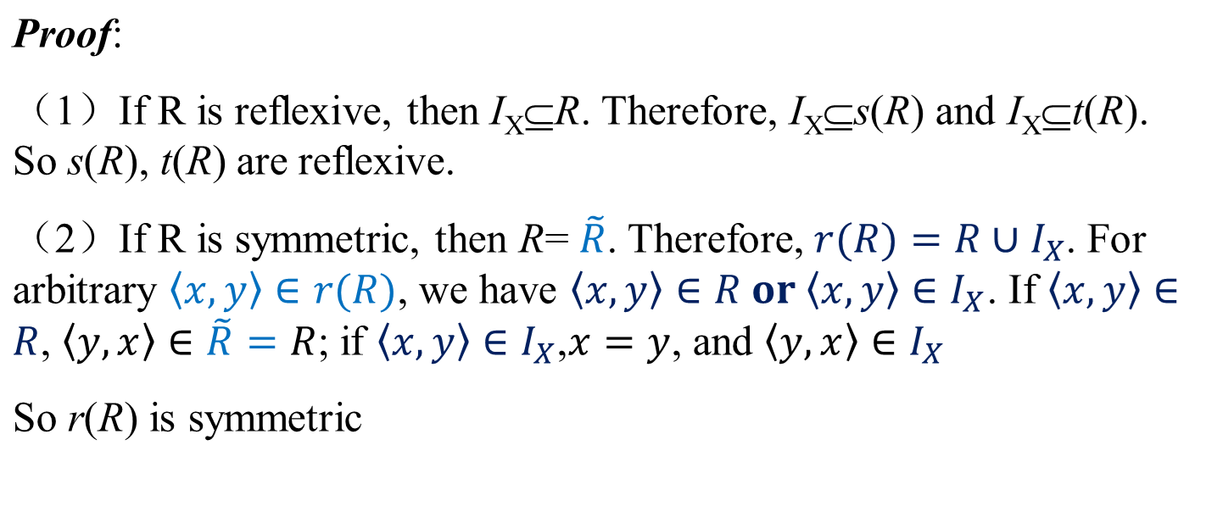
Closures operation of relations
关系的性质
关系的表示
关系图
关系矩阵
关系的运算
合成
幂
逆
闭包
Theorem: let X be a set, R is a relation on X, so there is
（1）If R is reflexive, then s(R), t(R) are reflexive；
（2）If R is symmetric, then r(R), t(R) are symmetric；
（3）If R is transitive, then r(R) is transitive.

Slide 11
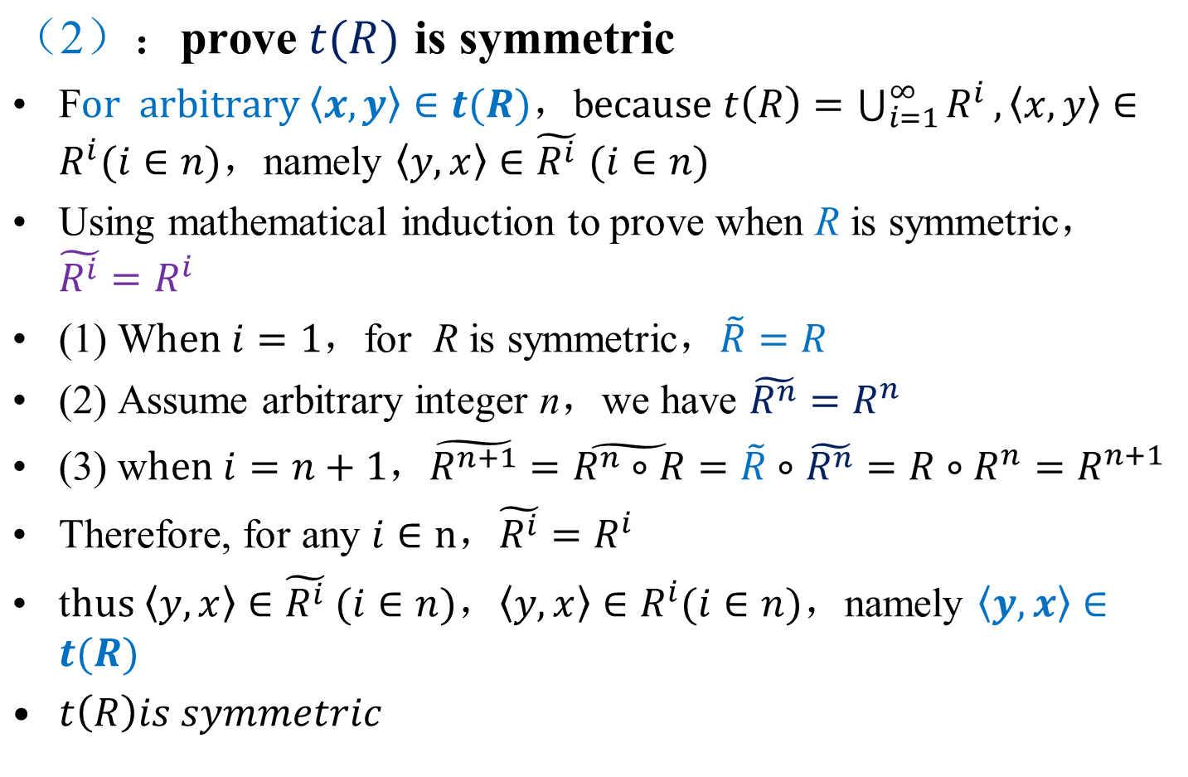
Closures operation of relations
关系的性质
关系的表示
关系图
关系矩阵
关系的运算
合成
幂
逆
闭包

Slide 12
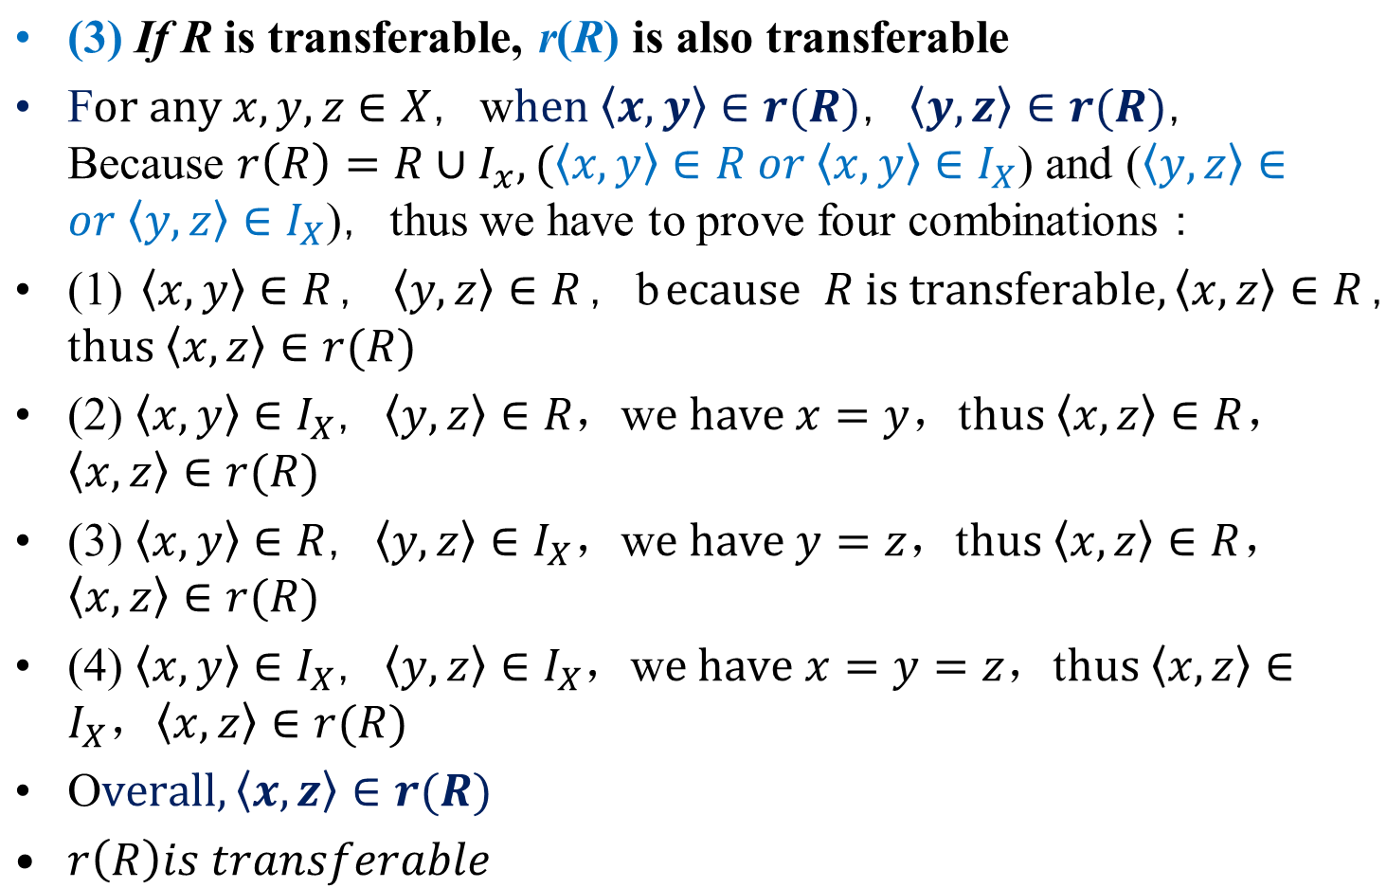
Closures operation of relations
关系的性质
关系的表示
关系图
关系矩阵
关系的运算
合成
幂
逆
闭包

Slide 13
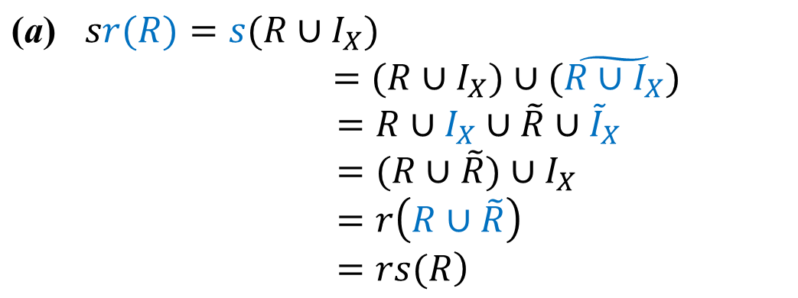
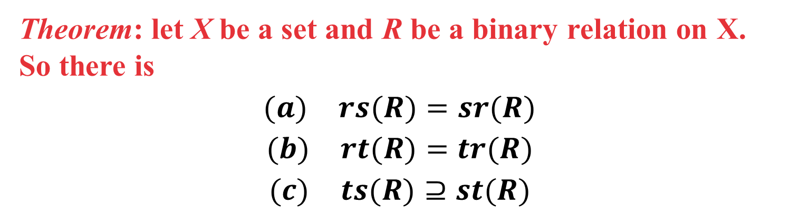
Closures operation of relations
关系的性质
关系的表示
关系图
关系矩阵
关系的运算
合成
幂
逆
闭包
Theorem: let X be a set and R be a binary relation on X. So there is
$$(a) rs(R)=sr(R)$$
$$(b) rt(R)=tr(R)$$
$$(c) ts(R)⊇st(R)$$
Proof：

Slide 14
Closures operation of relations
关系的性质
关系的表示
关系图
关系矩阵
关系的运算
合成
幂
逆
闭包
Proof:（b）because
therefore

Slide 15

Closures operation of relations
关系的性质
关系的表示
关系图
关系矩阵
关系的运算
合成
幂
逆
闭包
$$(c) ts(R)⊇st(R)$$
Proof:（c）if R₁⊇R₂ ，then s(R₁)⊇s(R₂) and t(R₁)⊇t(R₂).
s(R)⊇R, so ts(R)⊇t(R) and sts(R)⊇st(R).
s(R) is symmetric, so ts(R) is also symmetric and sts(R)=ts(R).
ts(R)⊇st(R)
1
3
Definition:
（1） R⁺=t(R)
（2） R*=tr(R)
2

Slide 16
Chapter 4 Binary Relation
4.7 Specific relations

Slide 17
Partition(划分) and covering (覆盖)
特殊关系
集合的划分和覆盖
等价关系
相容关系
Definition：Given nonempty set S，assume nonempty A={A₁,A₂,…, A_{n}}，if
then set A is the covering of the set S.
For example：S={a,b,c}，A ={{a,b},{b,c}}，B={{a},{b,c}}，A and B are the coverings of S.

Slide 18
Partition and covering
特殊关系
集合的划分和覆盖
等价关系
相容关系
Definition：Given nonempty set S，assume nonempty set A={A₁,A₂,…, A_{n}}，if
then A is a partition（划分） of S.
Element A_{i} in A is called the class of the partition.
The number of classes in A is called the rank（秩） of partition.
Partition is a specific case of covering，that all elements in A do not intersect with each other.

Slide 19
Partition and covering
特殊关系
集合的划分和覆盖
等价关系
相容关系
Example：assume S={1,2,3}，consider following sets
a covering of S
a covering of S
a partition of S, the rank is 2
a partition of S, the rank is 1 ，minimum partition
a partition of S, the rank is 3 ，maximum partition

Slide 20
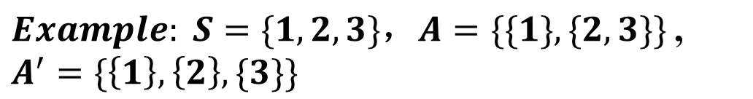
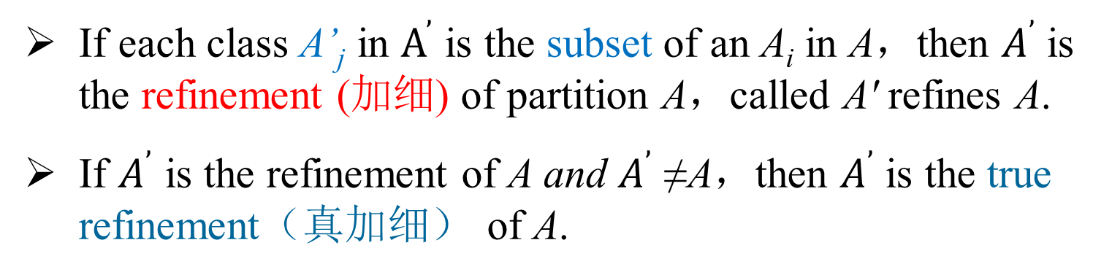
Partition and covering
特殊关系
集合的划分和覆盖
等价关系
相容关系
Definition：assume A and A' are two types of partition of nonempty set S，and can be expressed as:
If each class A’_{j} in $A^{’}$ is the subset of an A_{i} in A，then $A^{’}$ is the refinement (加细) of partition A，called A' refines A.
If $A^{’}$ is the refinement of A and $A^{’}$ ≠A，then $A^{’}$ is the true refinement（真加细） of A.

Slide 21
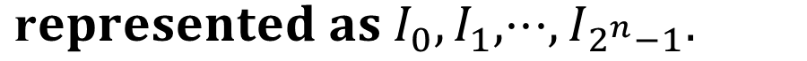
Miniterms or complete intersection
特殊关系
集合的划分和覆盖
等价关系
相容关系
Definition：The process of partition universal set E can be seen as drawing the boundary of the Venn graph. Assume A，B，C are the subsets of universal set. The classes partitioned by A, B, and C are called minterm (极小项) or complete intersection（完全交集）.
n subsets can generate 2^{n} minterms

Slide 22
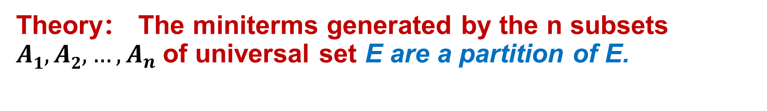
Partition and covering
特殊关系
集合的划分和覆盖
等价关系
相容关系
Theory： The miniterms generated by the n subsets $A1,A2,…,A_{n}$of universal set E are a partition of E.

Slide 23
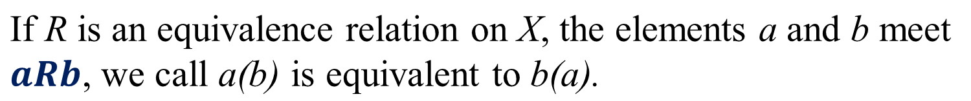
Equivalence Relation
特殊关系
集合的划分和覆盖
等价关系
相容关系
Definition：A relation R on a set X is called an equivalence relation if it is reflexive, symmetric, and transitive.
Example 1 The equal relation of number“=” is an equivalent relation on any set of numbers.
Example 2 The relation of the same surname in the set of a group of people is also equivalent.
But a relationship of friends is not equivalent because it is not transitive.

Slide 24
Equivalence Relation
特殊关系
集合的划分和覆盖
等价关系
相容关系
Example：Let set A={1,2,…,7}, R is a relation on A
R={<x,y> | x∈A ∧ y∈A ∧ (x-y) is divisible by 3}
Show that R is an equivalence relation.
Proof：the matrices of R ：
the digraph of R：

Slide 25
Equivalence Relation
特殊关系
集合的划分和覆盖
等价关系
相容关系
Definition：Let m be a positive integer and x, y∈Z. For an integer n, if there is x-y = n·m, then x and y are congruence (同余) modulo m and are expressed as: x≡y (mod m)
Theorem：Let R be a relation on a subset A in Z and xRy⇔x≡y (mod m). Then R is an equivalence relation.
Proof: (1) If A=∅, then R is an equivalence relation.
(2) If A≠∅, then
x∈A⇒(x-x)=0·m⇒xRx
x,y∈A∧xRy⇒∃n(n∈Z∧(x-y)=n·m)⇒∃n(n∈Z∧(y-x)=n·m) ⇒yRx
x,y,z∈A∧xRy∧yRz⇒∃n₁∃n₂(n₁,n₂∈Z∧(x-y)=n₁·m ∧(y-z)=n₂·m) ⇒∃n(n= n₁+n₂ ∈Z∧(x-z)=n·m)⇒xRz

Slide 26
Equivalence Relation
特殊关系
集合的划分和覆盖
等价关系
相容关系
Definition：Let R be an equivalence relation on a set A. The set of all elements b that are related to a, i.e., aRb is called the equivalence class of a. The equivalence class of a with respect to R is denoted by [a]_{R} or a/R. When only one relation R is under consideration, the subscript can be deleted as [a].
Example：let A={a,b,c,d},R is an equivalence relation on A, and
then

Slide 27
Properties of equivalence classes
特殊关系
集合的划分和覆盖
等价关系
相容关系
Theorem：Let R be an equivalent relation on a set A. Then the following statements for a and b of A are equivalent:
(1) aRb (2) [a]=[b] (3) [a]∩[b]≠∅
Proof：(1)⇒(2)
x∈[a]∧aRb⇔xRa∧aRb⇒xRb⇒x∈[b]⇒[a]⊆[b]
Similarly, [b]⊆[a] can be proven. Therefore [a]=[b]
(2)⇒(3) a∈[a]∧[a]=[b]⇒a∈[a]∩[b]⇒[a]∩[b]≠∅
(3)⇒(1) [a]∩[b]≠∅ ⇒∃x(x∈ [a]∩[b]) ⇒∃x(xRa∧xRb) ⇒∃x(aRx∧xRb)⇒aRb

Slide 28
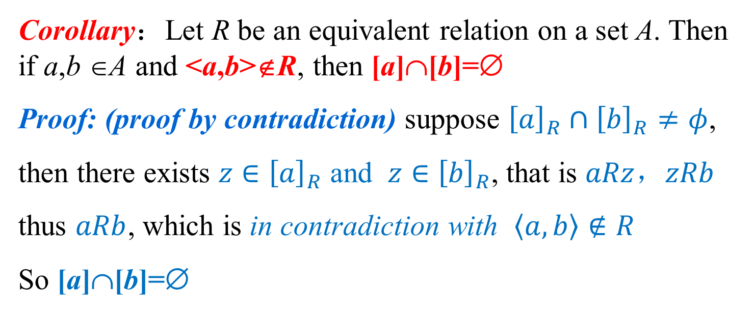
Properties of equivalence classes
特殊关系
集合的划分和覆盖
等价关系
相容关系
Theorem：Let R be an equivalent relation on a set A. Then the following statements for a and b of A are equivalent:
(1) aRb (2) [a]=[b] (3) [a]∩[b]≠∅
Corollary：Let R be an equivalent relation on a set A. Then if a,b ∈A and <a,b>∉R, then [a]∩[b]=∅
Proof: (proof by contradiction) suppose ${\left[a\right]}_{R}∩{\left[b\right]}_{R}≠φ$,
then there exists $z∈{\left[a\right]}_{R}$ and $z∈{\left[b\right]}_{R}$, that is $aRz$，$zRb$
thus $aRb$, which is in contradiction with $\left\langle a,b\right\rangle ∉R$
So [a]∩[b]=∅

Slide 29
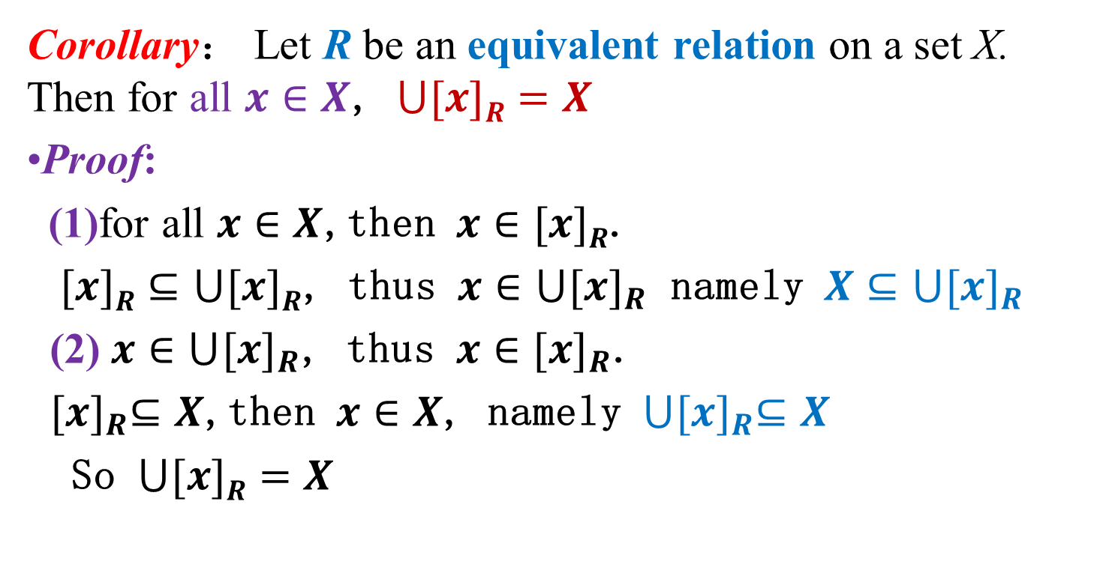
Properties of equivalence classes
特殊关系
集合的划分和覆盖
等价关系
相容关系
Corollary： Let R be an equivalent relation on a set X. Then for all $x∈X$, $⋃[x]R=X$
Proof:
(1)for all $x∈X$,then $x∈[x]R$.
$[x]R⊆⋃[x]R$, thus $x∈⋃{[x]}_{R}$ namely $X⊆⋃{[x]}_{R}$
(2) $x∈⋃{[x]}_{R}$, thus $x∈{[x]}_{R}$.
${[x]}_{R}⊆X$,then $x∈X$, namely $⋃{[x]}_{R}⊆X$
So $⋃[x]R=X$

Slide 30
Properties of equivalence classes
特殊关系
集合的划分和覆盖
等价关系
相容关系
Example: Assume A = {a,b,c,d}, relation R on A is denoted as
R is the equivalence relation on A
The elements in the same equivalence class are equivalent to each other. Elements in different equivalence classes are not equivalent .
The equivalent classes generated by each element of A must cover A, and determine a partition of the set A.
Notes:
等价类的集合

Slide 31
Equivalence classes and partition
特殊关系
集合的划分和覆盖
等价关系
相容关系
Theorem: Let R be an equivalence relation on a nonempty set X, the equivalence class {[x]_{R}|x ∈X} of R is a partition of X.
Proof：from the previous theorem and corollary, it follows
[x]≠∅ for all x∈X
⋃[x]=X for all x∈X
[x_{i}]=[x_{j}] or [x_{i}]∩[x_{j}]=∅ for all x_{i},x_{j}∈X
Definition: Let R be an equivalence relation on a nonempty A. The set {[x]_{R}|x∈A} is called the quotient set (商集) of A to be partitioned by R and denoted as A/R or A (mod R)。

Slide 32
Equivalence classes and partition
特殊关系
集合的划分和覆盖
等价关系
相容关系
Example：Let R be the relation of “congruence modulo 3 ” on the set of integers Z. R can be represented as:
R={<x,y> | x,y∈Z∧x≡y(mod 3)}
Find the equivalent classes of R
Solution：the equivalent classes are
Z/R={[0]_{R},[1]_{R},[2]_{R}}
Let R be an equivalence relation on a set A, then R=A×A results in the minimum partition on A and R={<x,x>|x∈A} results in the maximum partition on A. Ordinary Partition

Slide 33
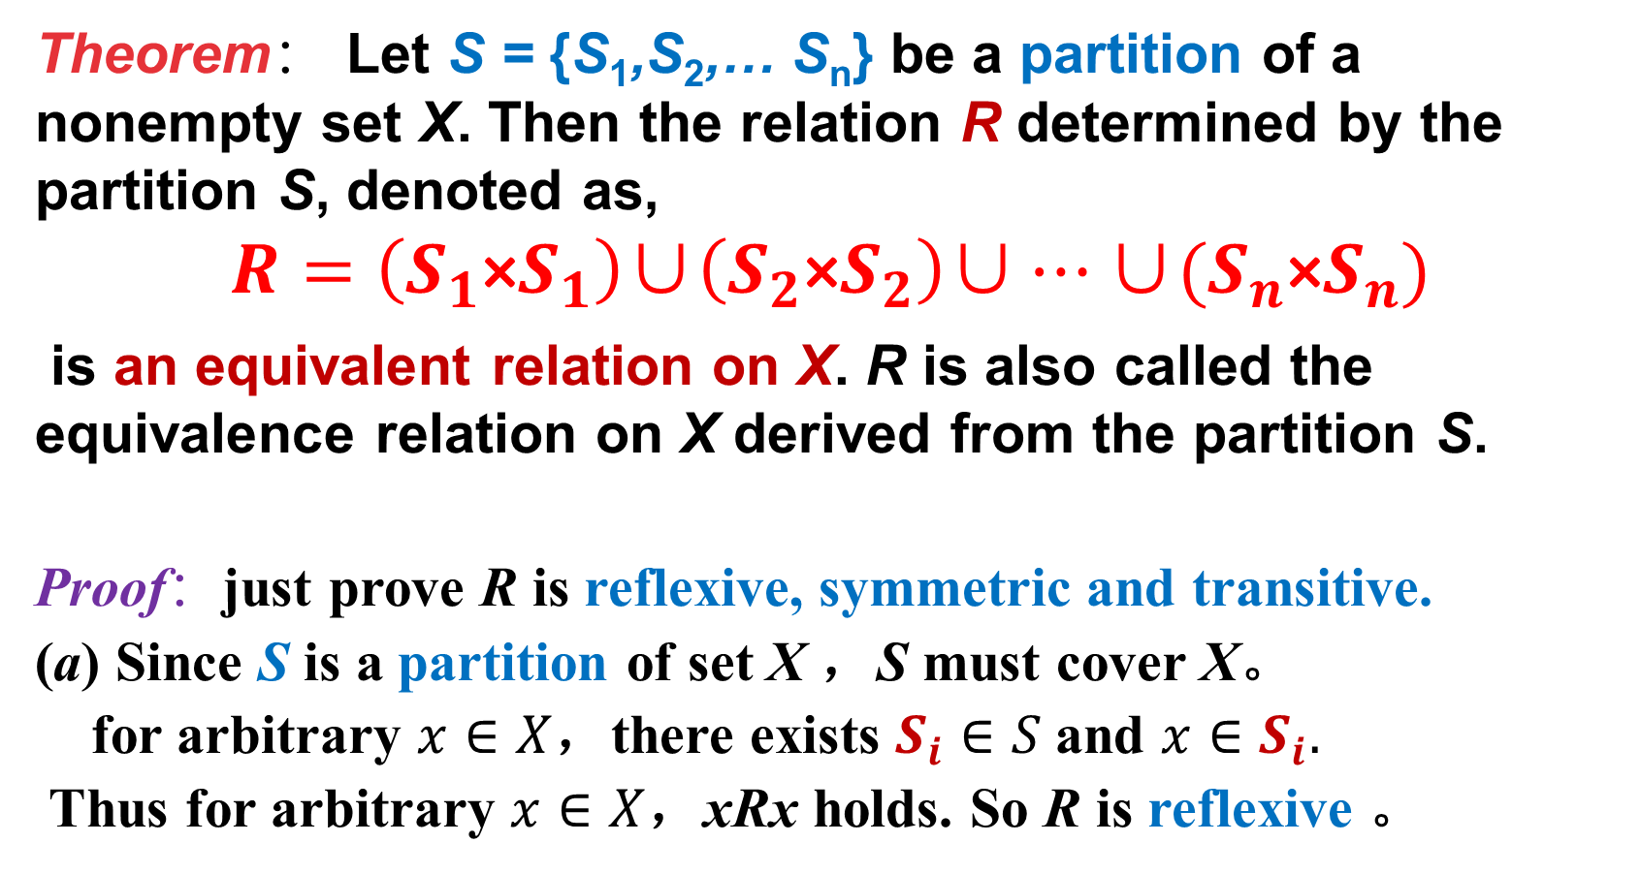
Equivalence classes and partition
特殊关系
集合的划分和覆盖
等价关系
相容关系
Theorem： Let S = {S₁,S₂,… S_{n}} be a partition of a nonempty set X. Then the relation R determined by the partition S, denoted as,
$$R=\left(S_{1}\text{×}S_{1}\right)\text{∪}\left(S_{2}\text{×}S_{2}\right)\text{∪}…\text{∪}(S_{n}\text{×}S_{n})$$
is an equivalent relation on X. R is also called the equivalence relation on X derived from the partition S.
Proof：just prove R is reflexive, symmetric and transitive.
(a) Since S is a partition of set X ，S must cover X。
for arbitrary $x∈X$，there exists $S_{i}∈S$and $x∈S_{i}.$
Thus for arbitrary $x∈X$，xRx holds. So R is reflexive 。

Slide 34
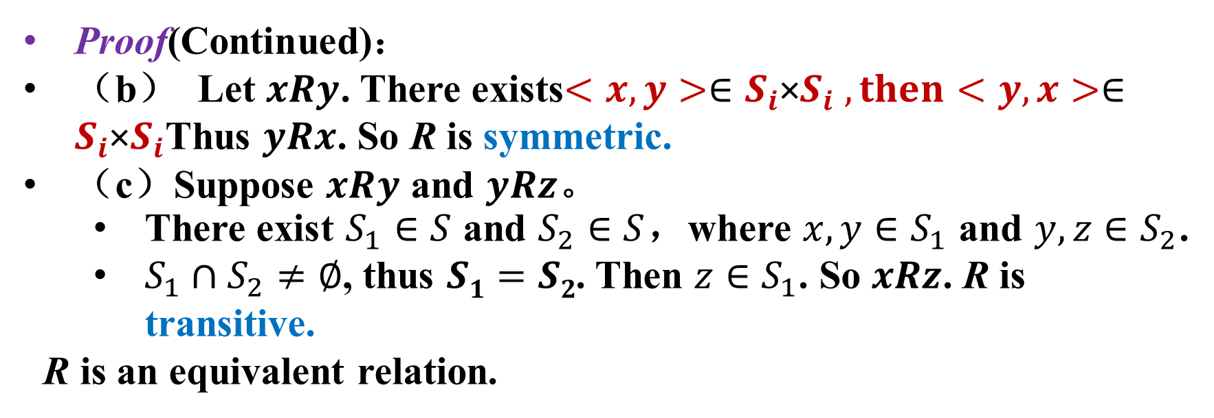
Equivalence classes and partition
特殊关系
集合的划分和覆盖
等价关系
相容关系
Proof(Continued)：
（b） Let $xRy$. There exists$<x,y>∈S_{i}\text{×}S_{i} , then<y,x>∈S_{i}\text{×}S_{i}$Thus $yRx$. So R is symmetric.
（c）Suppose $xRy$ and $yRz$。
There exist $S_{1}∈S$ and $S_{2}∈S$，where $x,y∈S_{1}$ and $y,z∈S_{2}$.
$S_{1}∩S_{2}≠∅$, thus $S1=S2$. Then $z∈S_{1}$. So $xRz$. R is transitive.
R is an equivalent relation.
可以看出，给定集合的一种划分，就可以写出一个等价关系。反过来，集合中的等价关系也能够生成该集合的划分。
Note: the equivalence relation in the set can generate the partition of the set. Conversely, any partition in the set can determine an equivalence relation.

Slide 35
Equivalence classes and partition
特殊关系
集合的划分和覆盖
等价关系
相容关系
Example：Let set A={a,b,c,d,e} and its partition C={{a,b},{c},{d,e}}. Find the equivalence relation R derived from the partition C
Solution：

Slide 36
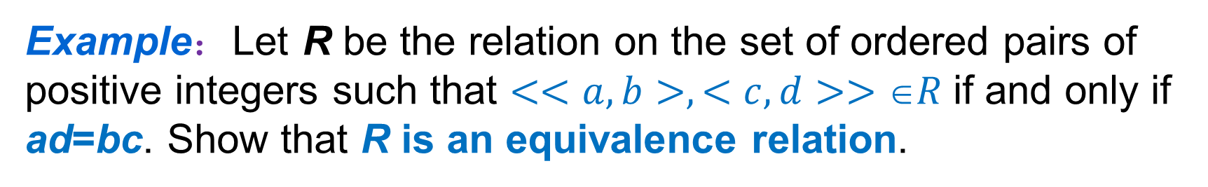
Equivalence classes and partition
特殊关系
集合的划分和覆盖
等价关系
相容关系
Example：Let R be the relation on the set of ordered pairs of positive integers such that $<<a,b>,<c,d>>R$if and only if ad=bc. Show that R is an equivalence relation.
Proof：suppose x,y,x₁,y₁,x₂,y₂,x₃,y₃∈Z⁺, then
xy=yx⇒ <<x,y>,<x,y>>∈R⇒R is reflexive
<<x₁,y₁>,<x₂,y₂>>∈R⇒x₁y₂=y₁x₂ ⇒x₂y₁=y₂x₁⇒ <<x₂,y₂>,<x₁,y₁>>∈R⇒R is symmetric
<<x₁,y₁>,<x₂,y₂>>∈R∧<<x₂,y₂>,<x₃,y₃>>∈R⇒ x₁y₂=y₁x₂∧x₂y₃=y₂x₃
⇒x₁y₂x₂y₃=y₁x₂y₂x₃⇒x₁y₃=y₁x₃⇒ <<x₁,y₁>,<x₃,y₃>>∈R ⇒R is transitive
R is an equivalence relation

Slide 37
Chapter 4 Binary Relation
4.7 Specific relations
The relation of compatibility

Slide 38
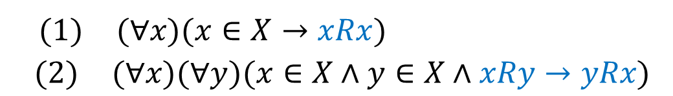
3. Relation of Compatibility (相容关系)
特殊关系
集合的划分和覆盖
等价关系
相容关系
Definition： Given the binary relation R in the set X, if R is reflexive and symmetric, then R is called a compatibility relation, which is denoted as ≈. In other words, R can be defined as：
Obviously, all equivalence relations are compatibility relations, but compatible relations are not necessarily equivalent relations.
For example，let X={2166,243,375,648,455}, a relation in X that

Slide 39
3. Compatibility relation
特殊关系
集合的划分和覆盖
等价关系
相容关系
In a compatibility relationship，if xRy, then x and y are said to be compatible（相容的）. In the previous example，X={2166,243,375,648,455}，let x₁=2166,x₂=243,x₃=375,x₄=648,x₅=455，then x₁Rx₂ , x₂Rx₃， while x₁ x₃，
It can be seen that the compatibility relation R is not transitive.
Writing R as follows:

Slide 40
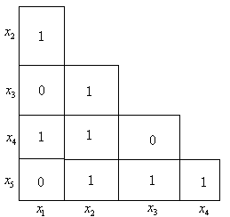
3. Compatibility relation
特殊关系
集合的划分和覆盖
等价关系
相容关系
Because the compatibility relation is reflexive, every element on the diagonal line of the matrix should be l, and the compatibility relation is symmetric, so the matrix is symmetric with respect to the principal diagonal line. In this way, it is sufficient to simply give the triangular part of the lower part of the relation matrix。
The relational matrix of R is as follows:

Slide 41
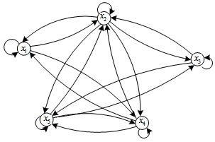
3. Compatibility relation
特殊关系
集合的划分和覆盖
等价关系
相容关系
The digraph of R is as follows:
Because of the reflexive and symmetric of the compatibility relation, there are ring edges on all nodes in the graph, and there are round-trip arcs between the two nodes with compatibility relation. If you delete the ring edges on all nodes and replace the two arcs between the two nodes with a straight line, you can simplify the graph as following:

Slide 42
3. Compatibility relation
特殊关系
集合的划分和覆盖
等价关系
相容关系
Still take X={2166,243,375,648,455} as an example
x₁=2166, x₂=243, x₃=375, x₄=648, x₅=455，
Let X₁={x₁,x₂, x₄}, X₂={x₂,x₃,x₅}, X₃={x₂,x₄,x₅}
In the sets X₁，X₂ and X₃，the elements within the same collection are compatible. The union of these sets is the given set X，that is X=X₁⋃X₂⋃X₃. Therefore, the set A={X₁,X₂,X₃} defines an covering of the set X，but it does not constitute a partition of the set X.
Conclusion: the compatibility relation on a set can define a covering of the set, and the equivalence relation on a set can determine a partition of the set.

Slide 43
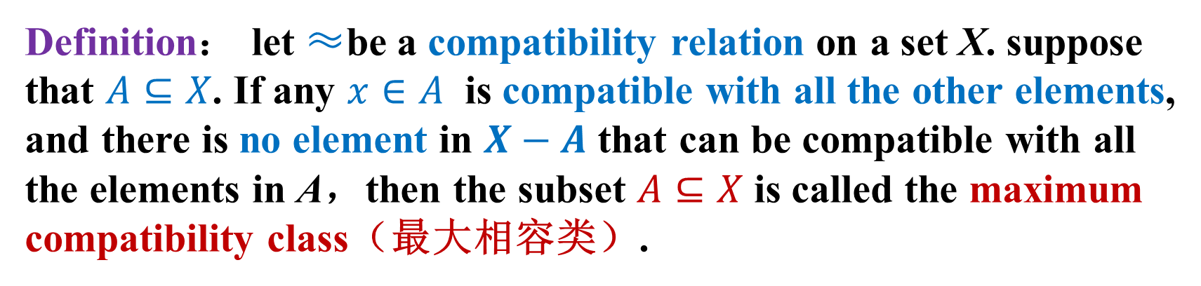
Maximum compatibility class
特殊关系
集合的划分和覆盖
等价关系
相容关系
Definition： let ≈be a compatibility relation on a set X. suppose that $A⊆X$. If any $x∈A$ is compatible with all the other elements, and there is no element in $X−A$ that can be compatible with all the elements in A，then the subset $A⊆X$ is called the maximum compatibility class（最大相容类）.
Methods for finding maximum compatibility class：
Relation digraph method
Relation matrix method

Slide 44
Finding maximum compatibility classes by relation digraph
特殊关系
集合的划分和覆盖
等价关系
相容关系
The key point of relation digraph method is to find out the maximum complete polygon (最大完全多边形).
The so-called complete maximum polygon refers to every vertex which is linked to all other vertices.
The node in the set that is only concerned with itself is a maximum complete polygon-- isolated node .
Two nodes connected by a straight line, which are not both connected to other nodes form a maximum complete polygon.
The three vertices of a triangle form a maximum complete polygon, the four vertices of a quadrilateral connected by diagonal lines constitute a maximum complete polygon, and the five vertices of a regular pentagram (正五角星) constitute a maximum complete polygon. The six vertices of a regular hexagram (正六边形) are also a maximum complete polygon.
A maximum complete polygon corresponds to a maximum compatibility class.

Slide 45
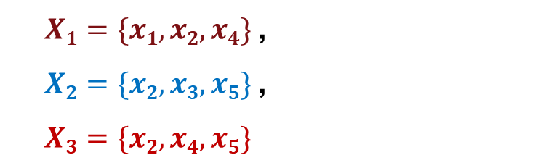
Finding maximum compatibility classes by relation digraph
特殊关系
集合的划分和覆盖
等价关系
相容关系
Triangle x₁x₂x₄, x₂x₃x₅, x₂x₄x₅ are the maximum complete polygons; the maximum compatibility classes corresponding to them are:
$X1=\{x1,x2, x4\}$,
$X2=\{x2,x3,x5\}$,
$X3=\{x2,x4,x5\}$

Slide 46
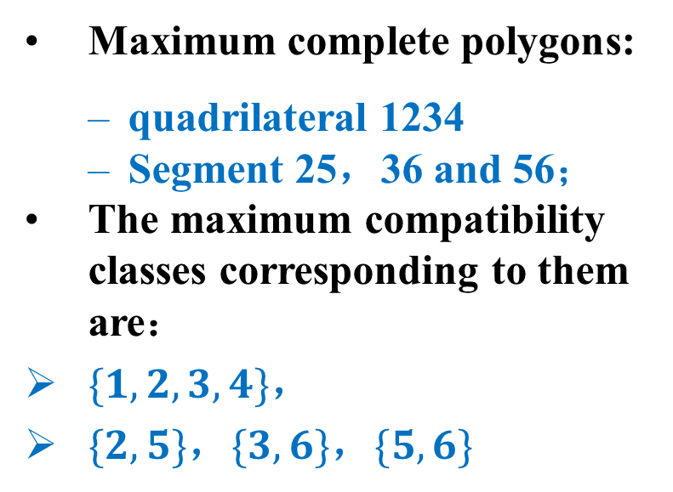
Finding maximum compatibility classes by relation digraph
特殊关系
集合的划分和覆盖
等价关系
相容关系
For example：In the following diagram, two compatibility relation digraphs are given. Try to find all their maximum complete polygons and find their corresponding maximum compatibility classes.
Maximum complete polygons:
quadrilateral 1234
Segment 25，36 and 56；
The maximum compatibility classes corresponding to them are：
$\{1,2,3,4\}$，
$\{2,5\}$，$\{3,6\}$，$\{5,6\}$

Slide 47
Finding maximum compatibility classes by relation digraph
特殊关系
集合的划分和覆盖
等价关系
相容关系
Maximum complete polygons ：triangle 123，136，356 and isolated node 4； The maximum compatibility classes corresponding to them are ：{1，2，3}，{1，3，6}，{3，5，6} and {4}。

Slide 48
Finding maximum compatibility classes by relation matrix
特殊关系
集合的划分和覆盖
等价关系
相容关系
First, a simplified relation matrix is developed, followed by the following steps to find the maximum compatibility classes:
Those elements that are only compatible with themselves are able to form the maximum compatibility class separately, so the rows and columns in which these elements are located are removed from the matrix.
Scan the column from right hand to the left hand of the simplified matrix until at least one nonzero column is found. The non-zero value in this column represents the corresponding compatible pair. Listing all such pairs.

Slide 49
Finding maximum compatibility classes by relation matrix
特殊关系
集合的划分和覆盖
等价关系
相容关系
(3) Continue to scan left until finding the next column with at least one non-zero value.
Enumerates compatible pairs corresponding to all non-zero values in this column.
In these obtained compatible pairs, if an element has a compatibility relation with all elements in a previously identified compatibility class, the element is merged into the compatibility class；
If an element is only compatible with some elements of the previously identified compatibility classes, these mutually compatible elements can be used to form a new compatibility class.
Removes those compatible pairs that have been included in any compatibility class, and lists all compatible pairs that have not been included in any compatibility class.
(4) Repeat step (3)，Until all columns of the simplified matrix have been scanned.
Finally, those compatibility classes that contain only isolated elements are also the maximum compatibility classes.

Slide 50
Finding maximum compatibility classes by relation matrix
特殊关系
集合的划分和覆盖
等价关系
相容关系
For example：please give the simplified matrix corresponding to the compatibility relation in the following diagram, and the maximum compatibility class.
2 | 1
3 | 1 | 1
4 | 1 | 1 | 1
5 | 0 | 1 | 0 | 0
6 | 0 | 0 | 1 | 0 | 1
 | 1 | 2 | 3 | 4 | 5

Slide 51
Finding maximum compatibility classes by relation matrix
特殊关系
集合的划分和覆盖
等价关系
相容关系
Solution：There are no isolated nodes,
so ignore (1). According to (2) and (3) :
The first column from the right is l, so there
is compatible pair {5，6}.
(b) The second column is full of 0. There are two
1s on the third column. The compatible pairs
corresponding to them are {3，4} and {3, 6},
then {5，6}, {3，4}, {3，6} are obtained.
(c) There are three 1s on the fourth column, so there are {2，3}，{2，4} and {2，5}，thus {5，6}，{3，4}，{3，6}，{2，3}，{2，4}，{2，5} are obtained.
It can be seen that element 2 in compatible pairs {2，3} and {2，4}，are compatible with the two elements in {3，4} ，so they can be merged into a compatible class {2，3，4}. Then there are: {2，3，4}，{5，6}，{3，6}，{2，5}
2 | 1
3 | 1 | 1
4 | 1 | 1 | 1
5 | 0 | 1 | 0 | 0
6 | 0 | 0 | 1 | 0 | 1
 | 1 | 2 | 3 | 4 | 5

Slide 52
Finding maximum compatibility classes by relation matrix
特殊关系
集合的划分和覆盖
等价关系
相容关系
(d) There are three 1s in the last fifth column，{1，2}，{1，3} and {l，4}. Then there are: {2，3，4}, {5，6}，{3，6}，{2，5}，{1，2}，{l，3}，{1，4}
It can also be seen that the elements 1 in compatibility pair {1，2}，{1，3} and {1，4} have compatibility relations with all the elements in compatible class {2，3，4} ，so they can be merged into a single compatible class {1，2，3，4}．Then there are
{l，2，3，4}，{5，6}，{3，6}，{2，5}.
These are the maximum compatibility classes.
2 | 1
3 | 1 | 1
4 | 1 | 1 | 1
5 | 0 | 1 | 0 | 0
6 | 0 | 0 | 1 | 0 | 1
 | 1 | 2 | 3 | 4 | 5

Slide 53
Finding maximum compatibility classes by relation matrix
特殊关系
集合的划分和覆盖
等价关系
相容关系
For example：please give the simplified matrix corresponding to the compatibility relation in the following diagram, and the maximum compatibility class.
2 | 1
3 | 1 | 1
5 | 0 | 0 | 1
6 | 1 | 0 | 1 | 1
 | 1 | 2 | 3 | 5

Slide 54
Finding maximum compatibility classes by relation matrix
特殊关系
集合的划分和覆盖
等价关系
相容关系
Solution：Here node 4 is an isolated node, so the corresponding rows and columns are deleted in the matrix. According to steps (2)
and (3),
(1) {4}
(2) {4}，{5,6}
(3) {4},{5,6},{3,5},{3,6}, merged: {4},{3,5,6}
(4) {4},{3,5,6},{2,3}
(5) {4},{3,5,6},{2,3} ,{1,2},{1,3},{1,6}，merged: {4},{3,5,6},{1,2,3} ,{1,3,6} ，herein, the element 1 in the compatible couple pair {1,3}, {1,6} ，is compatible with some elements in compatible class {3,5,6}, thus forming a compatible class {1,3,6}.
These are the maximum compatibility classes.
2 | 1
3 | 1 | 1
5 | 0 | 0 | 1
6 | 1 | 0 | 1 | 1
 | 1 | 2 | 3 | 5

Slide 55
Homework
P103
21
23(2)
24(a)(b)
25(3)
27(2)
29
下次课作业
P105：34,35,36,38,41

Slide 56
Homework

Slide 57

The End
Thanks

